Slide 1
Implementation of the Alumni Association platform for the University/Institute.
CSE7101- Capstone Project
Review-1
Batch Number: CSE_186
Under the Supervision of,
Dr./Mr./Ms./Prof.
Professor / Associate Professor / Assistant Professor
School of Computer Science and Engineering
Presidency University
Roll Number | Student Name
20231CSE3033 | HARSHAN T N
20231CSE3065 | SRINIVAS R
20231CSE3068 | ABDUL RAHEEM ALI KHAN
Name of the Program: B. Tech
Name of the HoD: Dr. Asif Mohammed
Name of the Program Project Coordinator: Dr. Jayavadivel Ravi
Name of the School Project Coordinators: Dr. Sampath A K , Dr. Geetha A

Slide 2
Content
Problem Statement
Objectives
Background and Related work for title Selection
Analysis of Problem Statement
Innovation or Novel Contributions
Git-hub Link
Timeline of the Project
References

Slide 3
Problem Statement
Organization: M N Technical Institute
Category (Hardware / Software / Both) :Software
Problem Description:
Alumni associations face challenges in maintaining engagement and fostering continuous interaction.
No centralized system for networking, mentorship, and alumni updates.
Difficulty in managing donations securely and transparently.
Limited access to alumni achievements and success stories.
Inefficient job posting and search mechanisms within the alumni network.

Slide 4
Objectives
Develop an integrated web & mobile platform for alumni engagement.
Provide easy alumni registration and profile management.
Implement a secure donation portal for supporting institutional projects.
Create a networking hub to connect alumni by profession, interest, or location.
Develop an alumni directory with advanced search capabilities.
Facilitate a job portal for career opportunities and mentorship.
Track and showcase alumni success stories.
Manage events and reunions through online tools.

Slide 5
Background & Related Work
Existing platforms (MIT, Stanford, IIT Alumni portals) provide basic profiles, events, and announcements.
Limitations identified:
Lack of mobile integration.
Minimal personalized networking features.
Limited career-focused tools.
Our proposed system:
Combines web & mobile accessibility.
Integrates networking, jobs, donations, and events.
Offers a comprehensive and interactive alumni ecosystem.

Slide 6
Analysis of Problem Statement
Stakeholders: Alumni, current students, institute administration.
Key needs:
Centralized communication.
Easy profile management.
Career and mentorship opportunities.
Transparent donation tracking.
Current gaps: Disconnected communication channels, lack of digital engagement tools.
Impact: Low alumni participation, underutilized potential for collaboration and fundraising

Slide 7
Innovation / Novel Contribution
Cross-platform integration: Seamless access via web & mobile apps.
Smart alumni search: Filter by year, location, industry, and expertise.
Integrated career services: Job postings, internship offers, mentorship matching.
Real-time networking hub: Forums, chat, and group discussions.
Success story showcase: Inspire current students with alumni achievements.
End-to-end event management: Online announcements, registration, and attendance tracking.

Slide 8
GitHub Link
Project Repository: Kushan7/Alumni
Contains:
Frontend & backend source code.
Database schema.
Documentation for setup and deployment.

Slide 9
Timeline of the Project (Gantt Chart)
Week 1: Requirement gathering & analysis
Week 2: UI/UX design for web & mobile applications
Week 3: Backend development (core modules)
Week 4: Frontend integration (web & mobile)
Week 5: Testing & debugging of developed modules
Week 6: Feature integration (donations, jobs, events)
Week 7: Final testing & deployment of platform
Week 8: Documentation preparation & handover

Slide 10
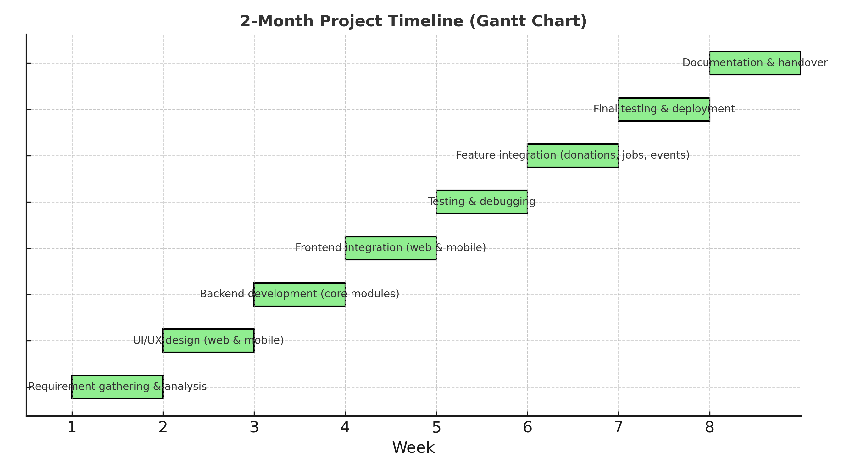

Slide 11
References (IEEE Paper format)
Kushan7/Alumni GitHub Repository
MIT Alumni Portal – https://alum.mit.edu
Stanford Alumni Association – https://alumni.stanford.edu
Research articles on alumni engagement & community platforms

Slide 12


